Slide 1
A Project Review-I Presentation on BiLSTM-based Indian Legal Case Summarization and Q&A System
Submitted in partial fulfillment of Final Year Computer Engineering Course- Major Project
In
Department of Computer Engineering
By
Prathmesh Dudhale (122B1B078)
Aditya Joshi (122B1B110)
Aaditesh Kadu (122B1B122)
Vedant Kale (122B1B124)
Under the Guidance of
Prof. Sushma Vispute
______________
Department of Computer Engineering PCET’s Pimpri Chinchwad College of Engineering
(A. Y. 2025-26)
1

Slide 2
Index
Problem Statement
Literature Survey
Objectives
Project Timeline
System Architecture
Tools & Technologies
Module Implementation
Testing & Validation
Paper Publication Details
Conclusion

Slide 3
Problem Statement
Indian legal documents are extremely lengthy, complex, and time-consuming to read manually. Lawyers, researchers, and students struggle to extract key information quickly. There is a need for an automated system that can summarize legal judgments and answer questions accurately.

Slide 4
Motivation
Why This Project Matters
⚖ Indian courts generate millions of pages annually
👨‍ Lawyers spend 30–40% time on document reading & research
📚 Law students struggle with quick understanding of judgments
🚀 LegalTech adoption in India is still in early stages

Slide 5
Project Objectives
To analyze the challenges in processing Indian legal documents using NLP.
To collect and preprocess Indian legal judgments and case briefs.
To design a BiLSTM Encoder–Decoder architecture with attention.
To identify performance limitations and propose Transformer-based extensions.

Slide 6
Scope and Feasibility
Summarization of:
Supreme Court Judgments
High Court Judgments
Statutory Documents
Fact-based legal Q&A
English-language legal documents only

Slide 7
Literature Survey
Legal Q&A systems in Indian context
Legal document summarization techniques
BiLSTM vs Transformer-based architectures
RAG and multilingual legal datasets
📚 Total Papers Reviewed: 15+
📆 Year Range: 2021 – 2025

Slide 8
Literature Survey
Reference | Key Findings | Learning for Our Project
Nigam et al. (2023) | Modern AI models (GPT-based) perform well on Indian legal Q&A tasks, especially factual and short-context queries, but rely heavily on paid APIs and lack transparency. | A strong baseline system is needed that is cost-effective, explainable, and deployable without API dependency for Indian legal use cases.
Akter et al. (2025) | Legal text summarization research lacks domain-specific benchmarks, real-world implementations, and consistent evaluation for long legal documents. | Justifies building a practical, evaluated baseline system focused on Indian legal documents rather than only theoretical analysis.
Sharma et al. (2024) | Transformer-based models like PEGASUS and T5 achieve superior summarization quality but require high computational resources and large-scale infrastructure. | Confirms the need for a lightweight BiLSTM baseline first, with Transformers planned as a future enhancement.

Slide 9
Literature Survey Summary
Common Findings
Transformers outperform traditional models
Indian legal datasets are underrepresented
Lack of production-ready systems
Research Gaps Identified
No Indian-focused baseline model
Limited evaluation on real legal documents
Poor explainability in existing models

Slide 10
Requirement Analysis
Functional Requirements
Input: PDF/DOCX Legal Documents.
Core: Abstractive Summarization & Fact-based Q&A.
Non-Functional Requirements
Performance: High ROUGE-L scores (> 0.70 ).
Latency: Near real-time processing (<6s per doc).
Dataset Requirements
Source: Supreme Court & High Court Judgments (Web Scraping).
Size: 150 Documents (2000 - 50,000 words each).

Slide 11
Project Planning Timeline
• Phase 1: Dataset + Preprocessing
• Phase 2: Model Development
• Phase 3: Evaluation & Metrics
• Phase 4: UI + Deployment
• Phase 5: Paper publication

Slide 12
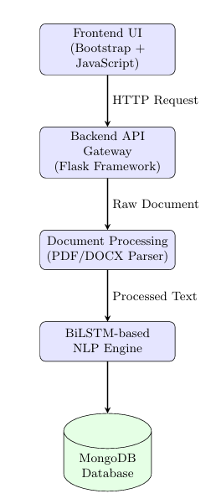
System Architecture

Slide 13
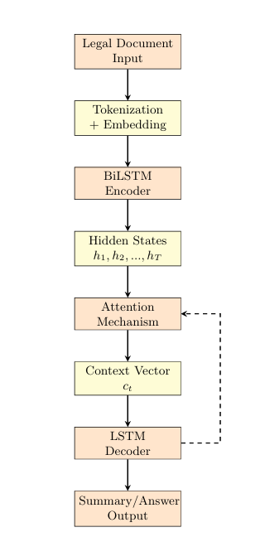
Model Architecture

Slide 14
Dataset Design & Preprocessing
Dataset Composition
Total Documents: 150 (Indian Legal Context)
Split: 120 Training / 30 Testing.
Types: Criminal, Civil, Constitutional, Corporate Law.
Preprocessing Steps
Text Cleaning: Regex removal of special characters/non-alphanumeric.
Tokenization: Word-level tokenization (Vocab limit: 20,000).
Padding: Max Text Length = 400, Max Summary Length = 60.

Slide 15
Tools & Technologies Stack
Languages & Core
Python 3.12
NumPy
Pandas
Deep Learning
TensorFlow / Keras
GloVe Embeddings
Scikit-Learn
Backend & Database
Flask (Python)
MongoDB Atlas
Pickle (Serialization)
Infrastructure
Google Colab (T4 GPU)
CUDA 11.3

Slide 16
Algorithm: Stacked BiLSTM + Attention
Encoder
Input: Tokenized Sequence (400)
Layers: Embedding (GloVe) -> BiLSTM (Layer 1) -> LayerNorm -> BiLSTM (Layer 2)
Output: Forward & Backward Hidden States
Decoder with Attention
Context Vector: Calculated via Attention Weights on Encoder States.
Generation: LSTM Decoder predicts next word using Context Vector + Previous Word.

Slide 17
Implementation Details (50%)
Model Specifications:
Total Params: 3,897,996 (Trainable)
Embedding Dim: 100 | Hidden Units: 256
Optimizer: Adam (LR=0.001) | Loss: Sparse Categorical Crossentropy
Training Progress:
Epochs: 25
Initial Loss: 5.02 -> Final Loss: 0.47
Initial Accuracy: 9.6% -> Final Accuracy: 86.3%

Slide 18
Testing & Validation Results
Summarization Metrics (Evaluation on 25 Docs)
ROUGE-L Score: 0.7038 (High semantic overlap)
BLEU Score: 0.5041(Translation quality)
Q&A Performance
F1-Score: 73.03%
System Performance
Avg Processing Time: 5.1 seconds/document
Throughput: ~702 documents/hour

Slide 19
Research Paper Publication
Title:
"BiLSTM-Based Indian Legal Case Summarization and Q&A: A Baseline Implementation with Transformer Extension"
Authors:
Sushma Vispute Mam, Prathmesh Dudhale, Aditya Joshi, Aaditesh Kadu, Vedant Kale
Abstract Summary:
Proposes a comprehensive system based on BiLSTM for processing legal documents, tested on 150 documents. Establishes a solid baseline (ROUGE-L 0.7038 ) while identifying the need for Transformer architectures for complex reasoning.

Slide 20
Conclusion & Future Work
Conclusion
Successfully implemented a BiLSTM Legal AI system.
Verified performance with ROUGE-L 0.7038 and high practitioner utility (Likert 3.74/5).
Future Work
Transformer Upgrade: Integrate LLMs (GPT-4/LLaMA) for better reasoning.
RAG Integration: Retrieval-Augmented Generation for citing specific laws.

Slide 21
References
[1] S. K. Nigam, S. K. Mishra, A. K. Mishra, N. Shallum, and A. Bhattacharya, “Legal Question-Answering in the Indian Context: Efficacy, Challenges, and Potential of Modern AI Models,” arXiv preprint arXiv:2309.14735, 2023.
[2] S. Akter, E. Cano, C. Weber, and M. Dobler, “A Comprehensive Survey on Legal Text Summarization: Techniques, Datasets, and Challenges,” arXiv preprint, 2025.
[3] R. Sharma et al., “Legal and Financial Document Summarization Using Transformer-Based Architectures,” Open Access International Journal of Science and Engineering, vol. 9, no. 8, pp. 1–15, 2024.

Slide 22
Thank You

